Slide 1
Group Assignment: SQL Injection Testing using SQLmap
GROUP MEMBERS:
HARSHAL SAWANT
ISHAN PRABHUNE
PRATIK DARADE
ANIKET SINGH
RAJ DEDHIA

Slide 2
Introduction
Welcome to our step-by-step guide on SQL Injection testing using SQLmap. SQL Injection is a serious web security vulnerability, and this presentation will help you understand how to identify and address it responsibly.
SQLMap, short for SQL Injection Mapper, is an open-source penetration testing tool used to automate the process of detecting and exploiting SQL injection vulnerabilities in web applications. SQL injection is a common and potentially devastating security vulnerability that occurs when an application doesn't properly validate or sanitize user input before constructing SQL queries. Attackers can exploit this vulnerability to gain unauthorized access to a database, extract sensitive information, or modify the database content.
The significance of SQL injection lies in its capacity to imperil the availability, confidentiality, and integrity of sensitive data. Databases that store user credentials, financial records, and personal information become susceptible to illicit entry by malicious individuals, putting individuals and businesses at risk of financial losses and damage to their reputation through identity theft, fraud, and other cybercrimes. Additionally, SQL injection attacks could lead to website defacement, where attackers alter the site's appearance to deceive and erode user trust.

Slide 3
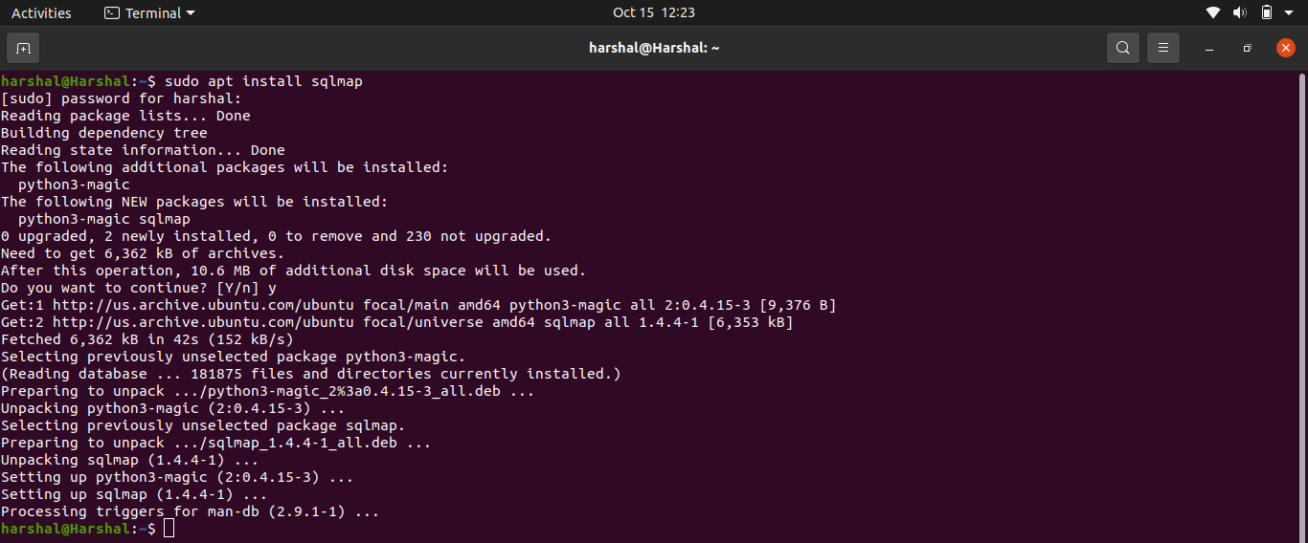
Step 1 - Install SQLmap
In this initial step, we'll cover the installation of SQLmap. Using version 1.4.4 stable is recommended, as it's a trusted release for detecting SQL Injection vulnerabilities. Proper installation is crucial before you proceed with any testing

Slide 4
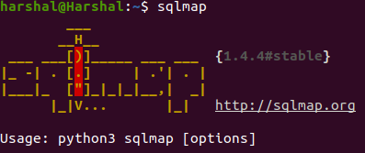
Step 2 - Running SQLmap
Once you have SQLmap installed, it's time to start using it. We'll guide you through how to run SQLmap and introduce you to the necessary commands and parameters.

Slide 5
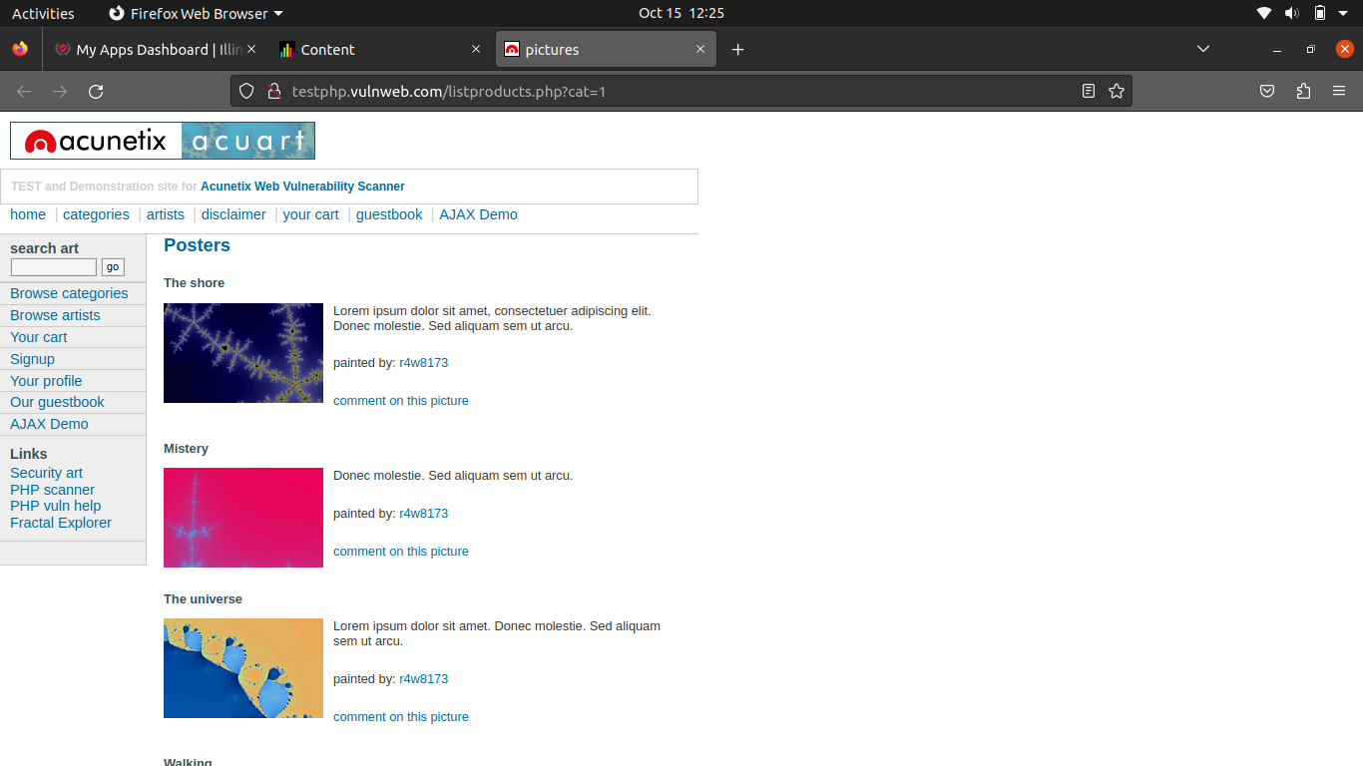
Step 3 - Selecting a Target URL
It's essential to stress that SQLmap testing on websites without authorization is illegal and unethical. Therefore, it's recommended to use it for educational purposes on your own website or sample sites provided by platforms like Acunetix

Slide 6
Step 4 - Analyzing the Target URL
With the target URL selected, we use the '-u' parameter to specify it for testing. SQLmap then analyzes this URL for potential SQL Injection vulnerabilities.

Slide 7
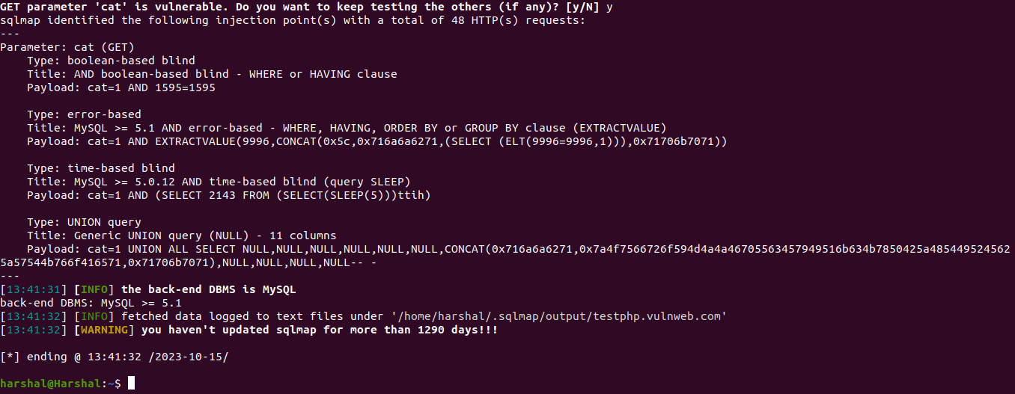
Step 5 - Results from SQLmap
After the analysis, SQLmap provides results, often revealing parameters such as 'cat' and the associated database, 'mysql.' These are indicators of potential vulnerabilities.

Slide 8
Step 6 - Checking Databases
This step involves checking the databases present within the target URL, a crucial part of understanding the data structure.

Slide 9

Step 7 - Output of Databases
We'll display the output of databases found, which is essential for understanding the available data.

Slide 10
Step 8 - Displaying Columns in a Table
To explore the database further, we use the '-D' and '-T' parameters. The '--columns' parameter helps to list the columns of the selected table.

Slide 11
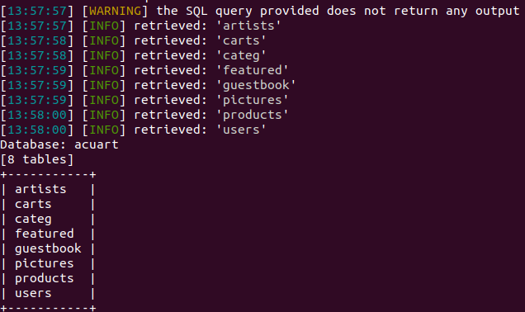
Step 9 - Choosing the Users Table
The users table often contains valuable user information. We'll guide you on how to select this table for further analysis.

Slide 12
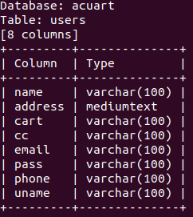
Step 10 - Displaying COLUMNS OF USER TABLES
In this step, you'll learn how to retrieve and display usernames from the users table. The '-C' and '--dump' parameters come into play for making the data visible on the terminal.

Slide 13
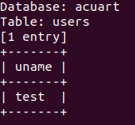
Step 11: Displaying the usernames in table users.
The usernames are displayed in this step using the command given below.

Slide 14
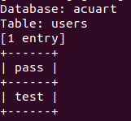
Step 12 - Displaying Password COLUMN
Building on the previous step, we'll explore how to retrieve passwords, highlighting the need for secure data handling.

Slide 15
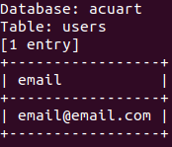
Step 13 - Displaying Email IDs
In this step, you'll discover how to access email addresses stored in the database, emphasizing the sensitivity of this information.

Slide 16
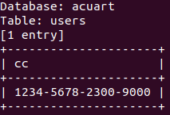
Step 14 - Displaying Credit Card Info
We'll cover how to retrieve credit card information. Responsible and ethical handling of such data is crucial.

Slide 17
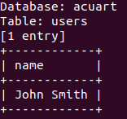
Step 15 - Display Names
This step focuses on retrieving names from the database and discusses potential uses for this data.

Slide 18

Step 16 - Logging into the Target URL
After extracting information, we'll explore how to securely log in to the target URL using the retrieved credentials.

Slide 19
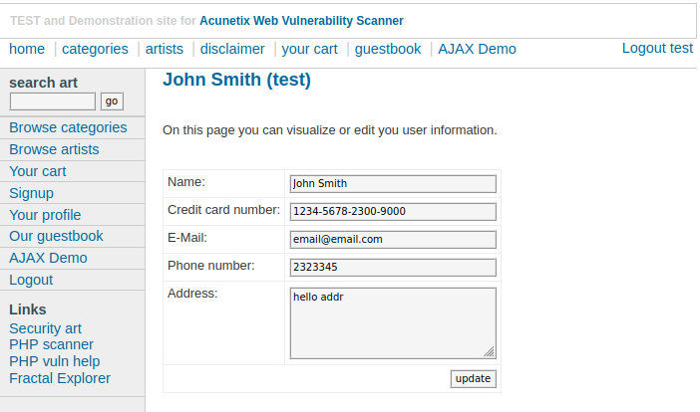
Step 17 - Profile Screen on Target URL
We'll delve into the profile screen on the target website, where users typically manage their account information. We'll discuss potential actions and responsibilities in this context

Slide 20
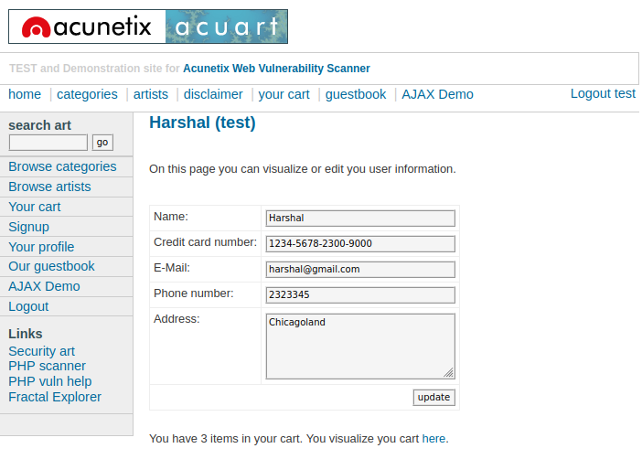
Step 18 - Modifying User Data
This step explains how to modify user data responsibly on the target website. Changes should be made with ethics in mind.

Slide 21
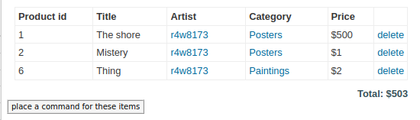
Step 19 - Modifying Cart Data
We'll discuss how to modify cart data on e-commerce websites securely and discuss the potential impact of SQL Injection on the user experience.

Slide 22
THANK YOU

